Slide 1
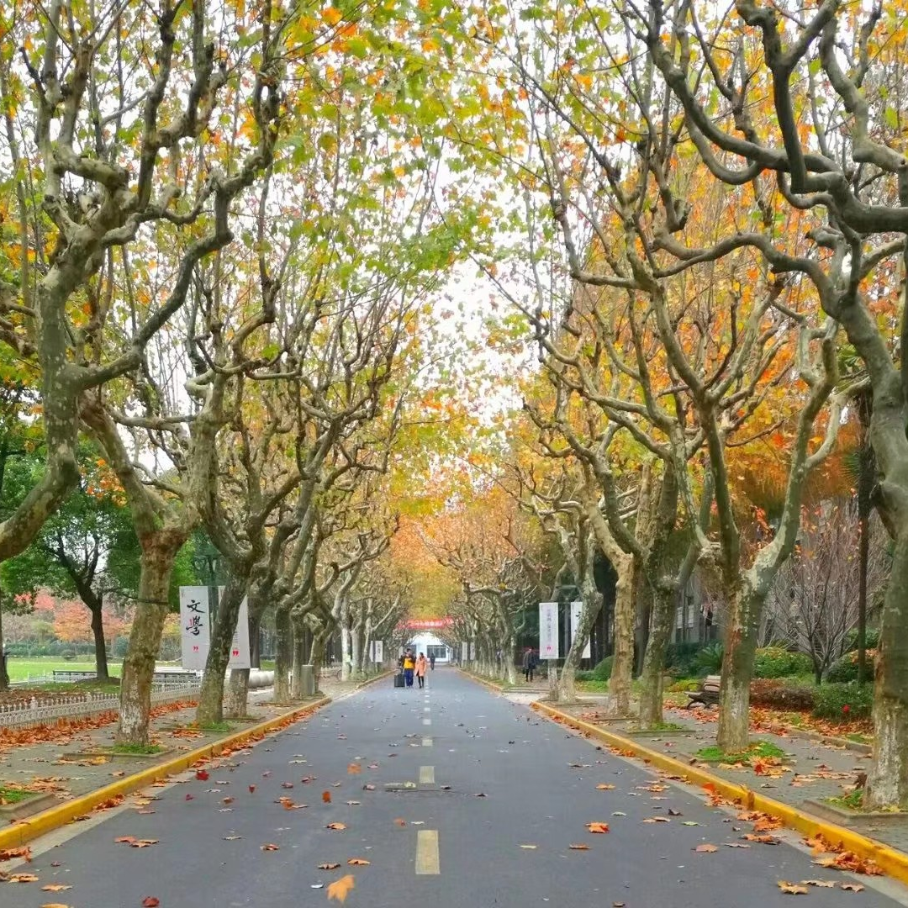
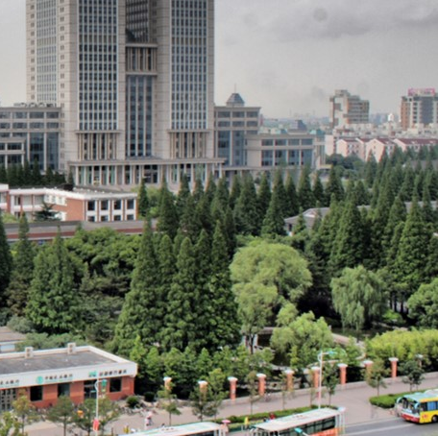
REPORT
TITLE
汇报人：XXX
学号：XXXXXXXXXXX
日期：XXXX年X月XX日

Slide 2

01
YOUR TITLE HERE
We welcome your play world
CONTENTS
02
YOUR TITLE HERE
We welcome your play world
03
YOUR TITLE HERE
We welcome your play world

Slide 3
01
«
YOUR TITLE HERE
We welcome your play world

Slide 4
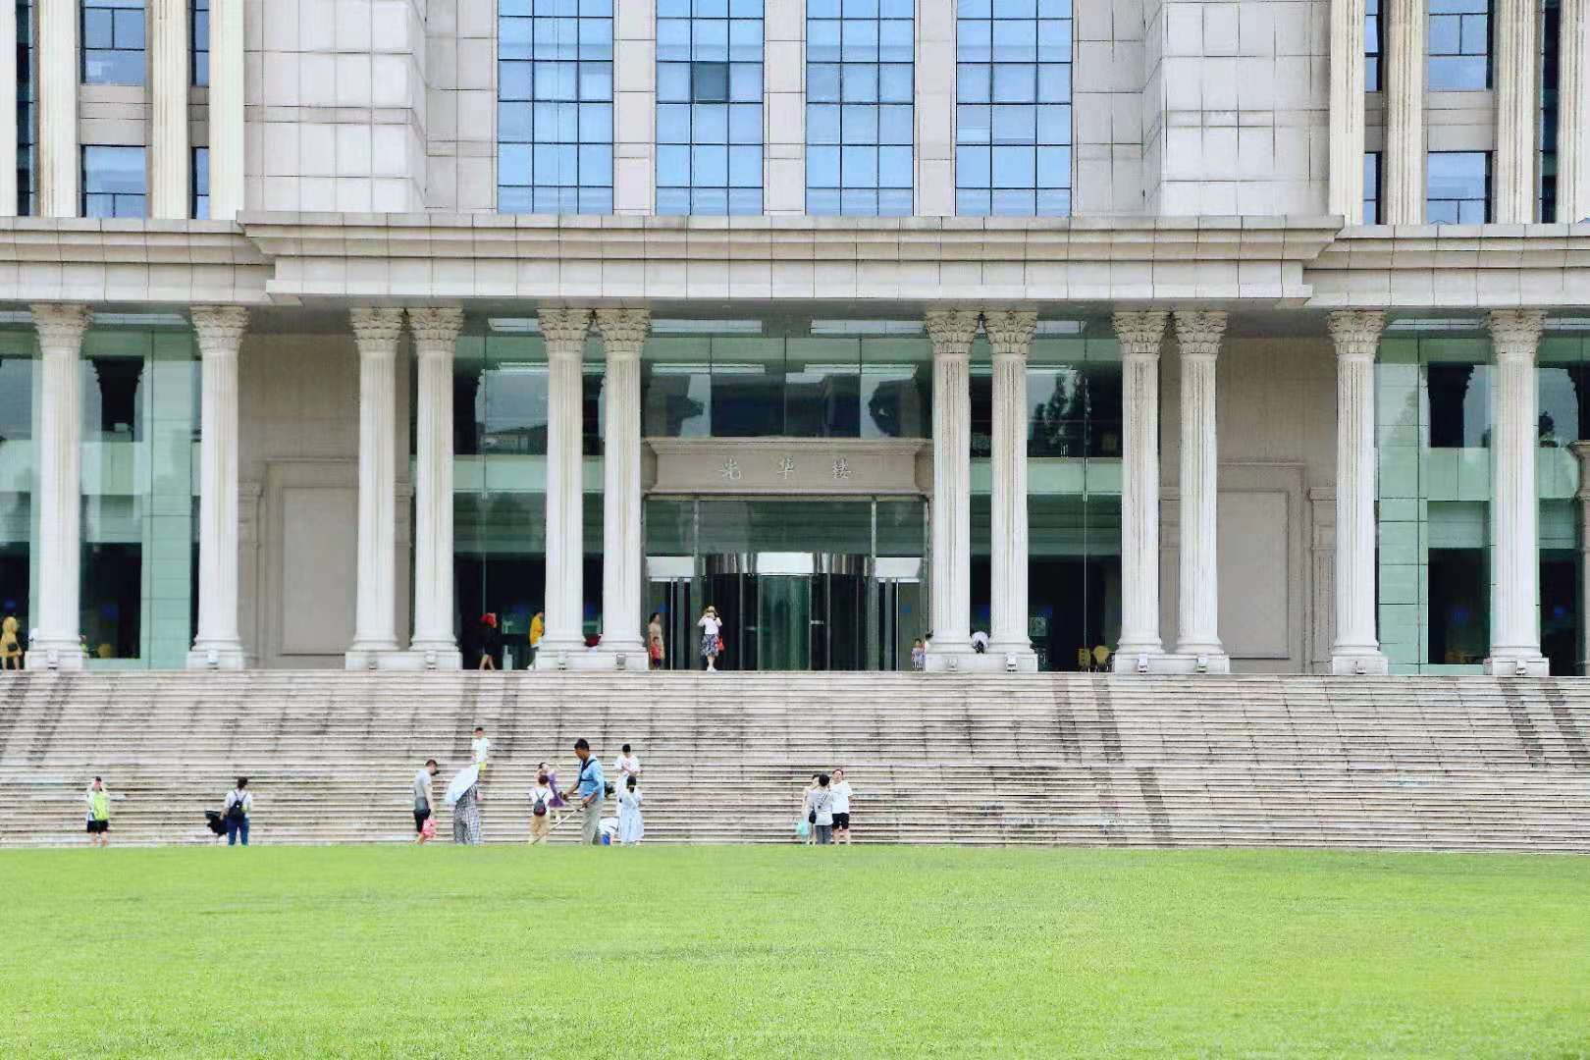
YOUR TITLE HERE
We welcome your play world network of sites put
01
02
03
«
«
YOUR TITLE HERE
YOUR TITLE HERE
YOUR TITLE HERE
We welcome your play world network of sites put f
We welcome your play world network of sites put f
We welcome your play world network of sites put f

Slide 5
请在此
输入
文字内容
Far far away, behind the word mountains, far from the countries Vokalia and Consonantia, there live the blind texts. Separated they live in Bookmarksgrove right at the coast of the Semantics, a large language ocean.
A small river named Duden flows by their place and supplies it with the necessary regelialia. It is a paradisematic country.

Slide 6
02
«
YOUR TITLE HERE
We welcome your play world

Slide 7
YOUR TITLE HERE
YOUR TITLE HERE
YOUR TITLE HERE
We welcome your play world network of sites put f
We welcome your play world network of sites put f
We welcome your play world network of sites put forward their valuable opinions or suggestions work, products and services
YOUR TITLE HERE
YOUR TITLE HERE
«
We welcome your play world network of sites put f
We welcome your play world network of sites put f

Slide 8
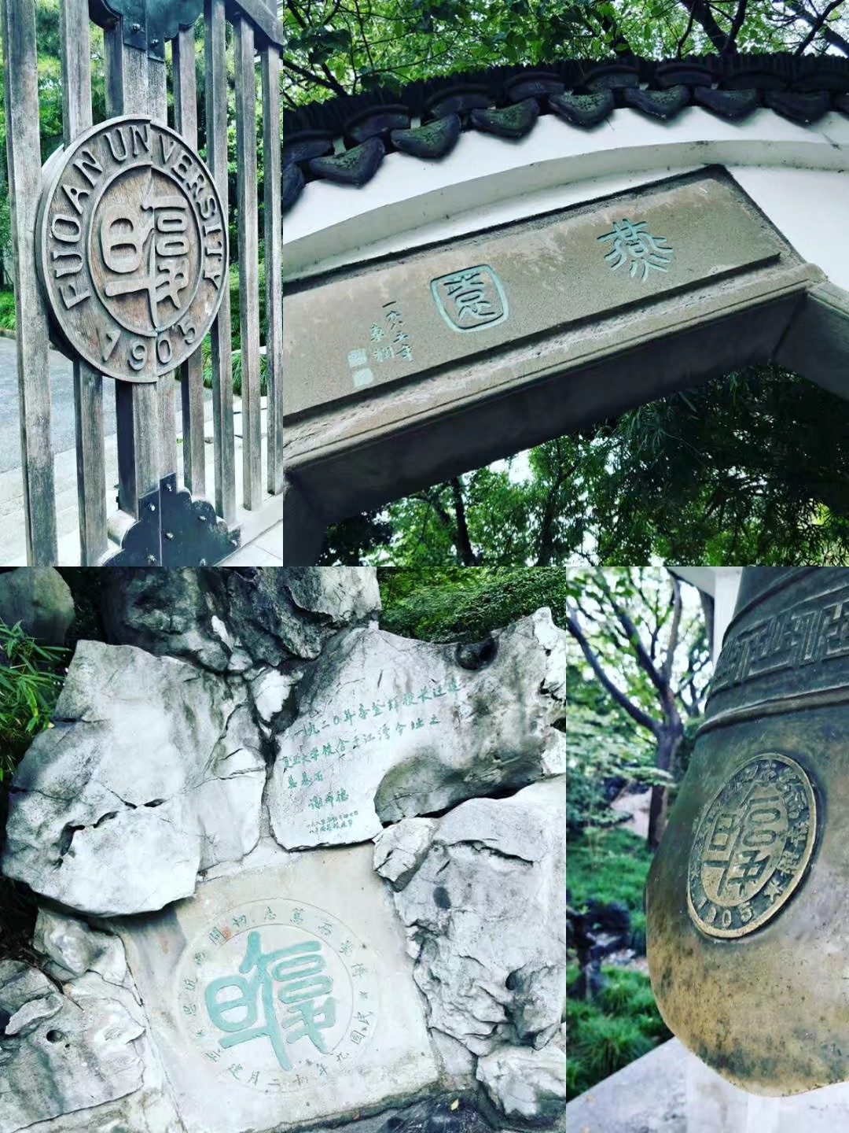
Far far away, behind the word mountains, far from the countries Vokalia and Consonantia, there live the blind texts. Separated they live in Bookmarksgrove right at the coast of the Semantics, a large language ocean.
A small river named Duden flows by their place and supplies it with the necessary regelialia. It is a paradisematic country.
在此
输入文字

Slide 9


在此
输入文字
Far far away, behind the word mountains, far from the countries Vokalia and Consonantia, there live the blind texts. Separated they live in Bookmarksgrove right at the coast of the Semantics, a large language ocean.
A small river named Duden flows by their place and supplies it with the necessary regelialia. It is a paradisematic country.

Slide 10
03
«
YOUR TITLE HERE
We welcome your play world

Slide 11
YOUR TITLE HERE
We welcome your play world network of sites
YOUR TITLE HERE
YOUR TITLE HERE
YOUR TITLE HERE
We welcome your play world network of sites put f
We welcome your play world network of sites put f
We welcome your play world network of sites put f

Slide 12
YOUR TITLE HERE
We welcome your play world network of sites
Far far away, behind the word mountains, far from the countries
Far far away, behind the word mountains, far from the countries
Far far away, behind the word mountains, far from the countries
Far far away, behind the word mountains, far from the countries

Slide 13
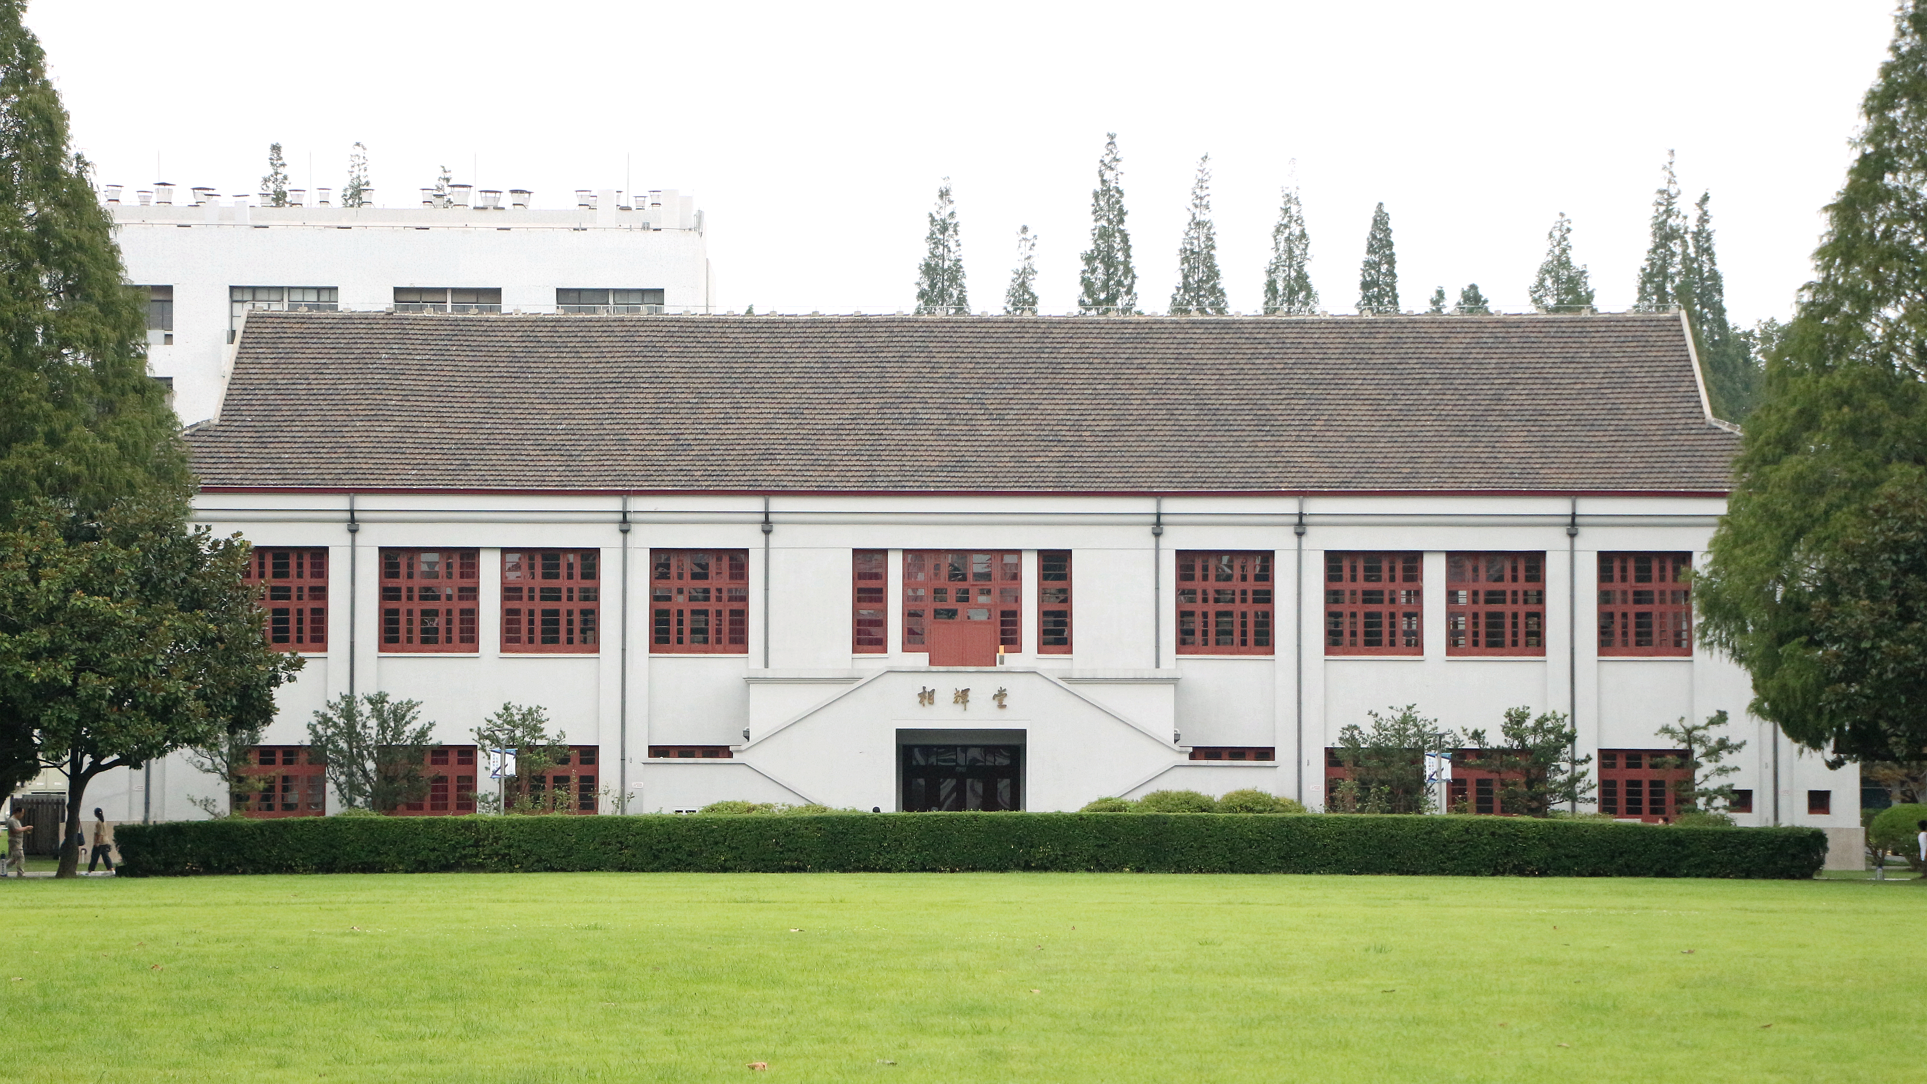
标题内容在这里
SUBTITLE HERE
THANK YOU

